Slide 1
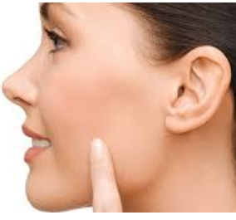
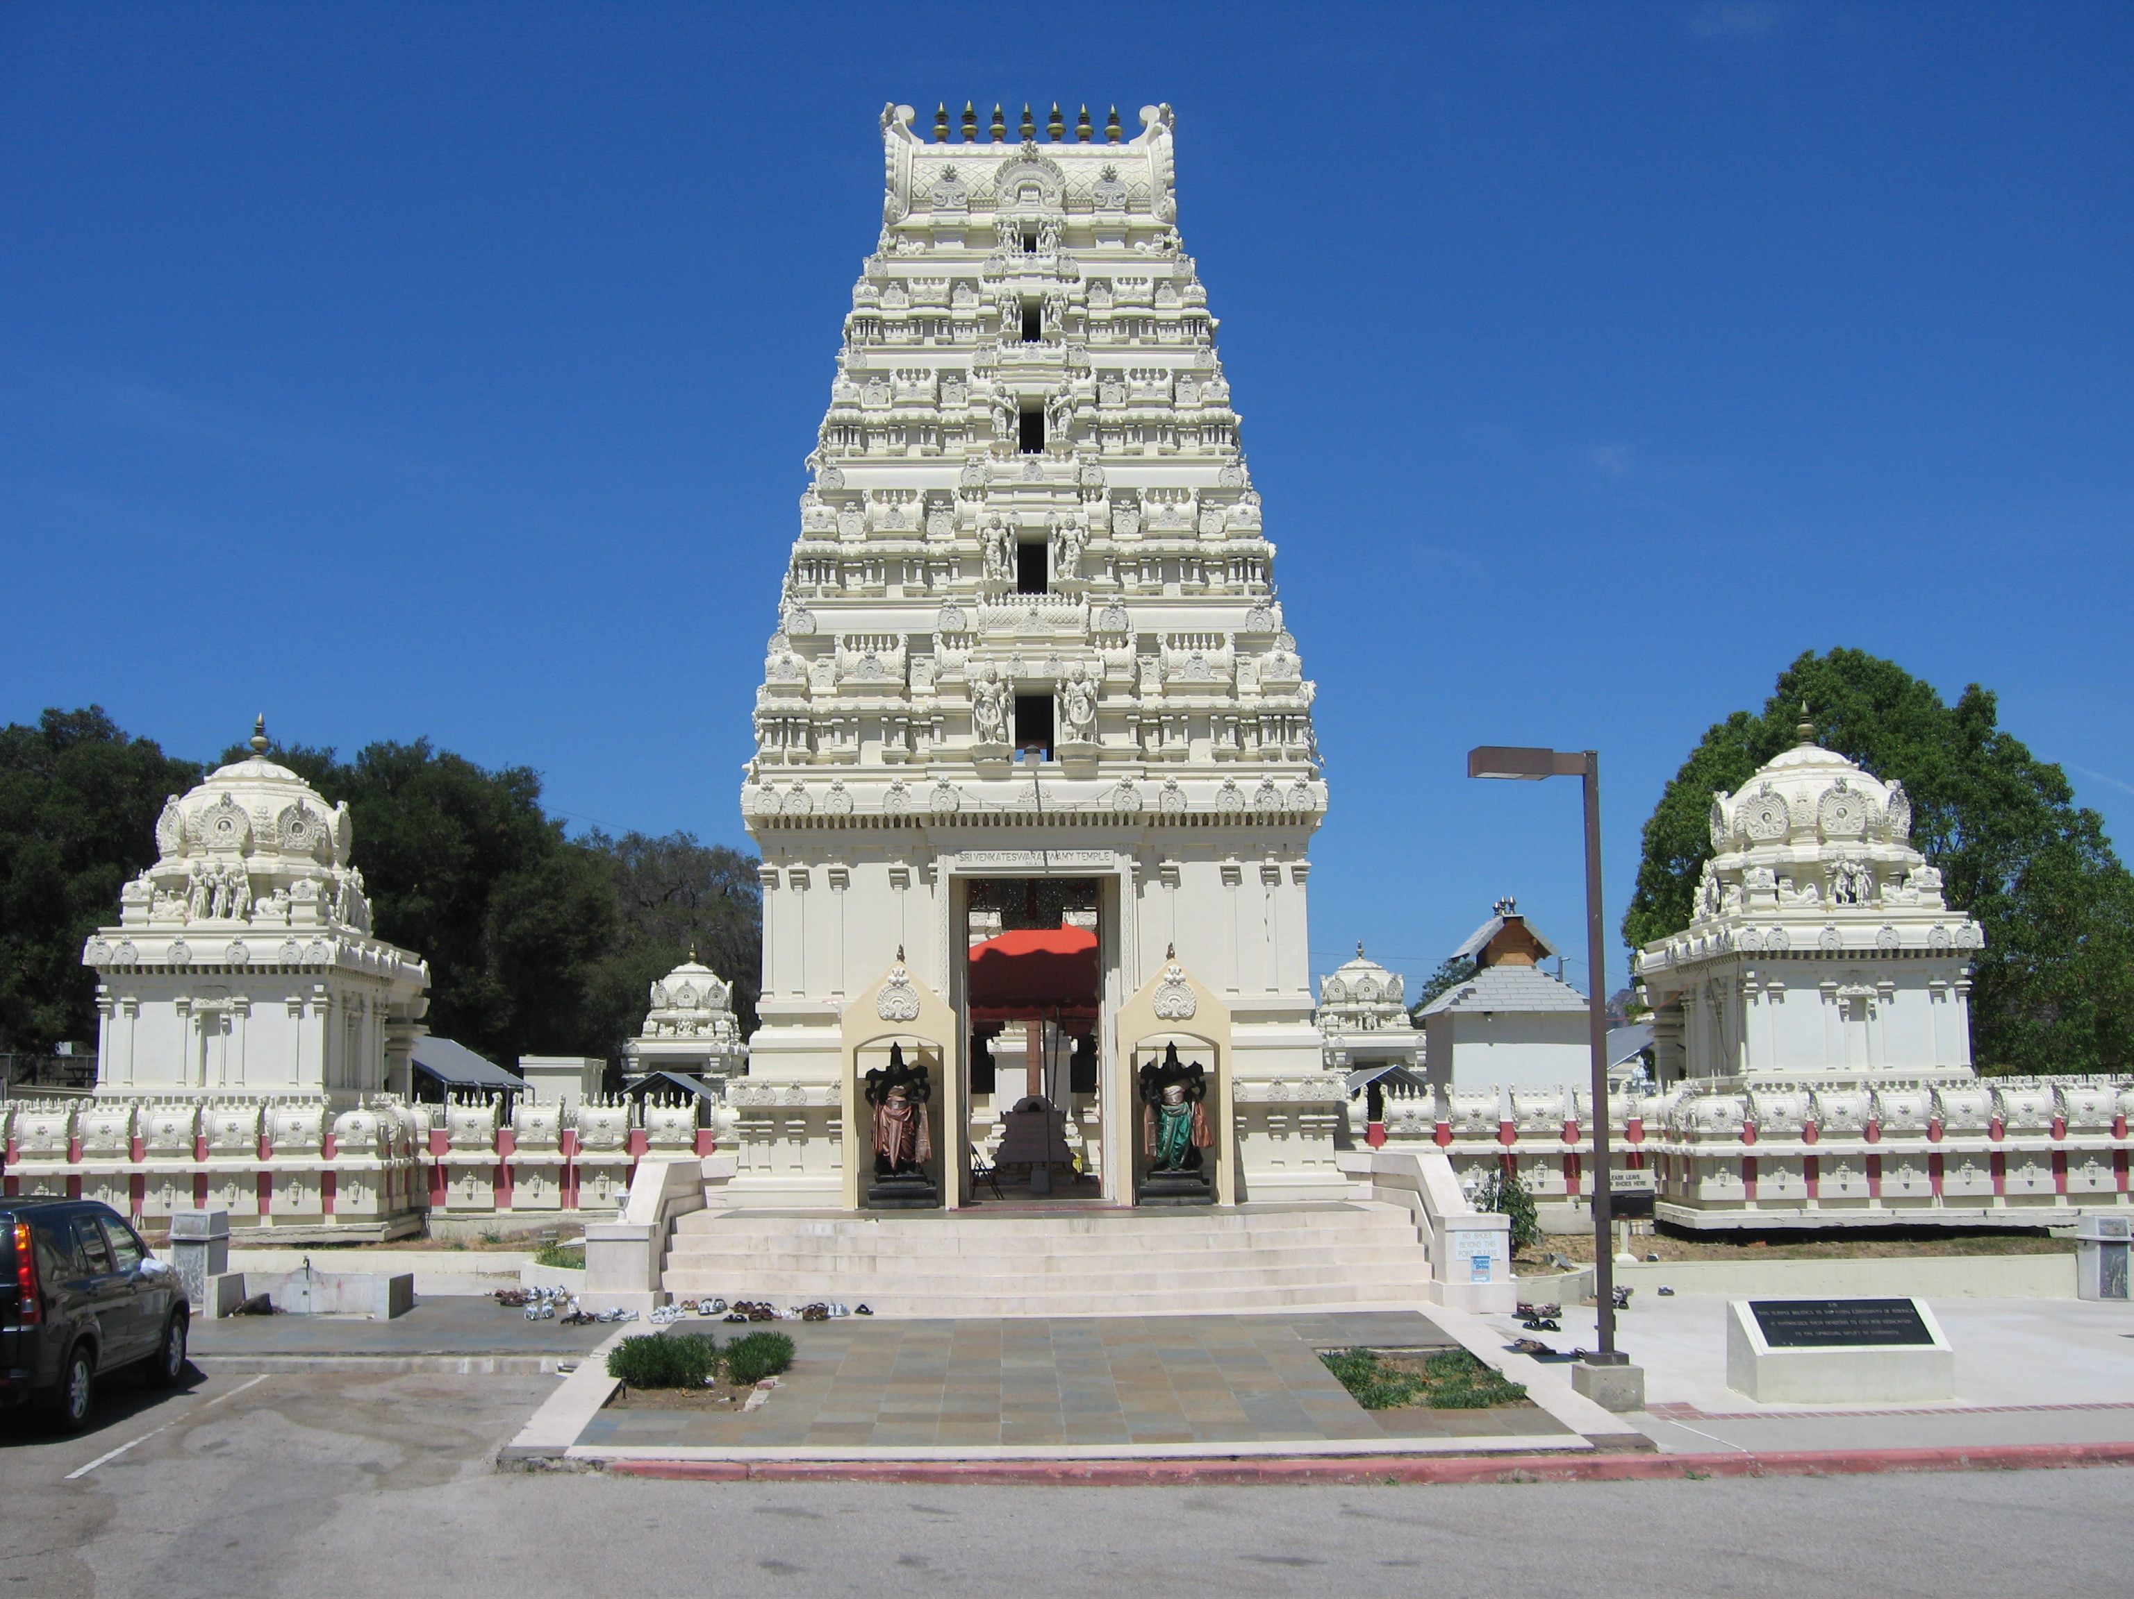
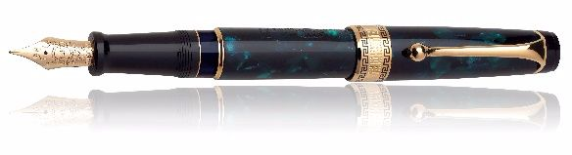
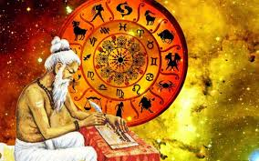
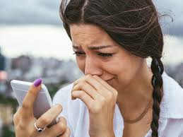
Puzzle #1
2/5
2/6
6/7
6/10
2/6

Slide 2
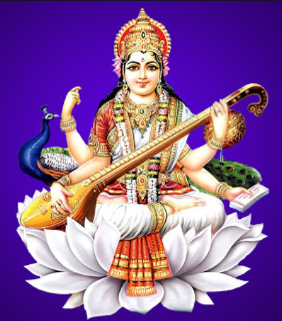
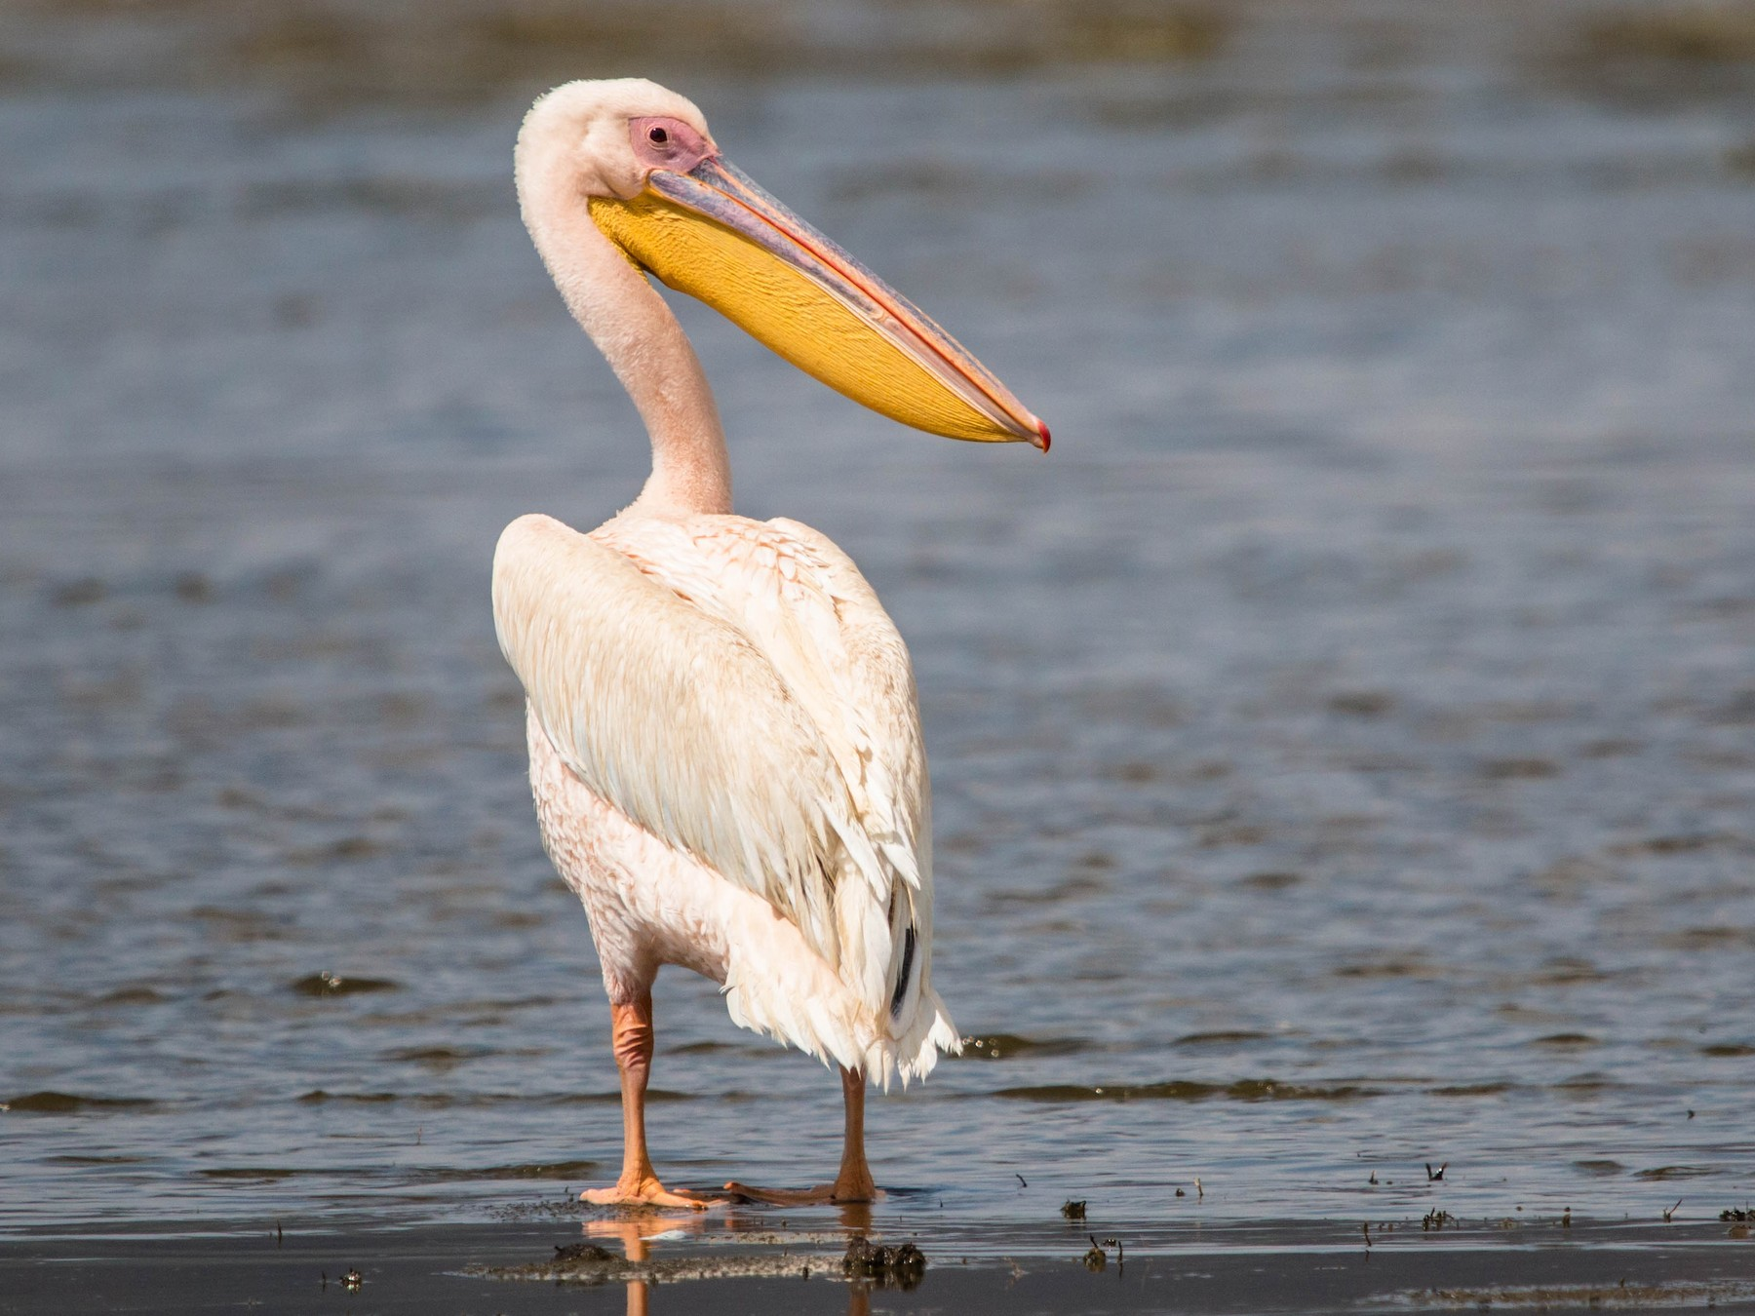
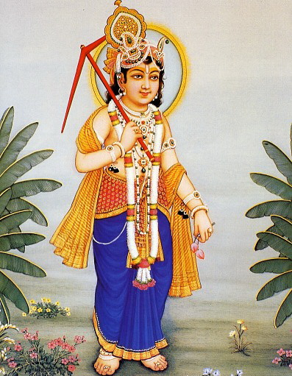
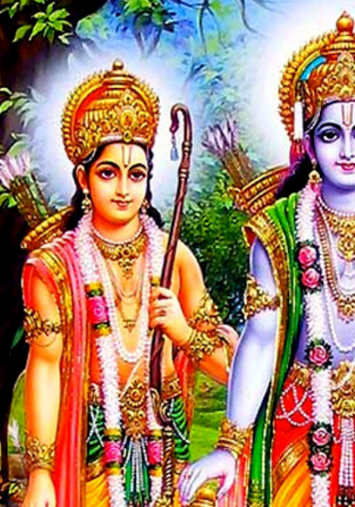
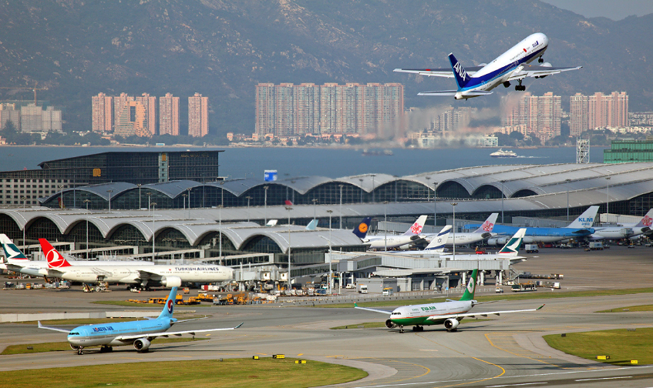
Puzzle #2
9/10
2/7
1/13
1/8
5/7

Slide 3

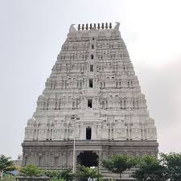
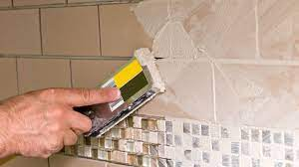
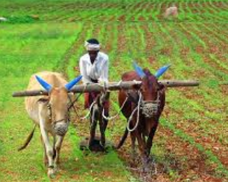
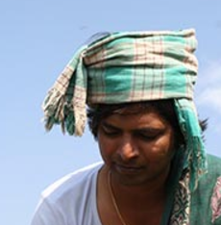
Puzzle #3
1/7
2/10
3/13
3/10
4/15

Slide 4
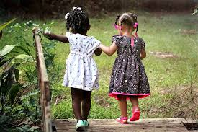
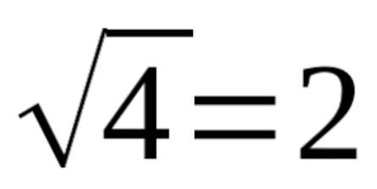
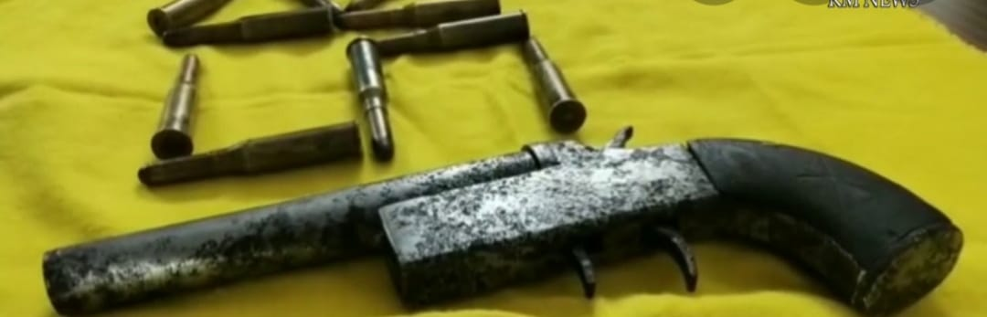
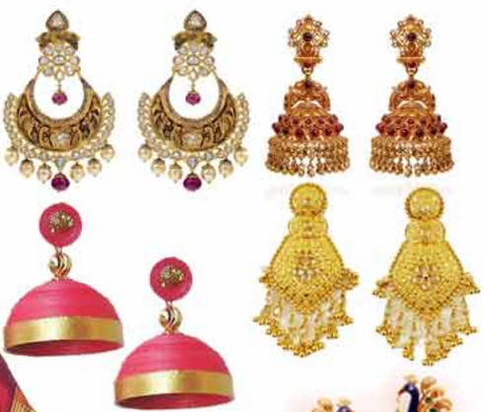

Puzzle #4
8/10
6/11
6/6
5/6
2/6

Slide 5
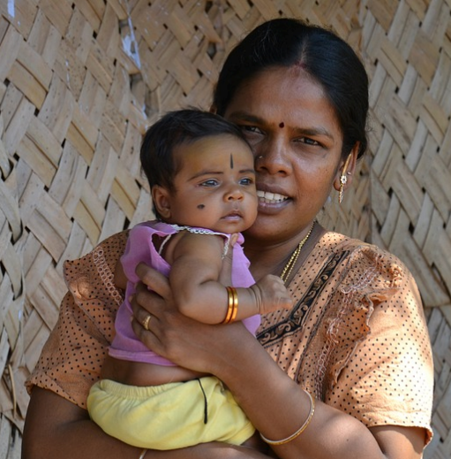

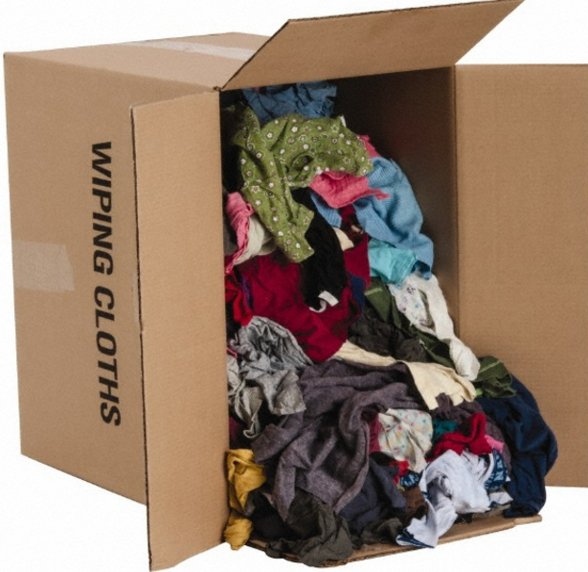
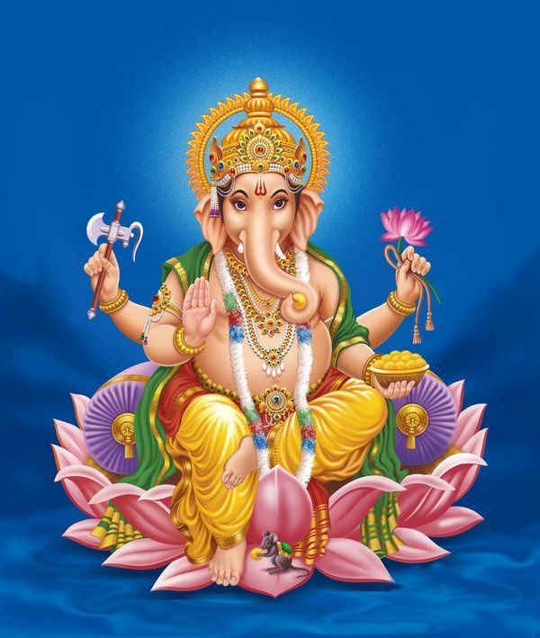
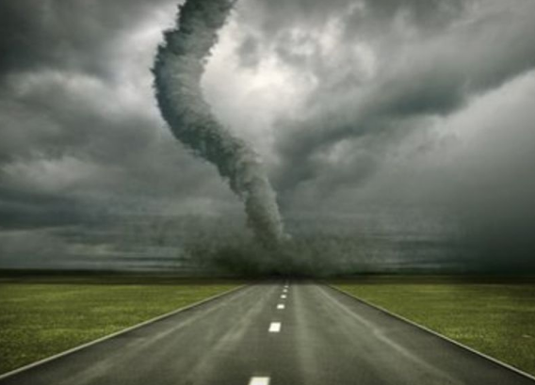
Puzzle #5
4/6
5/10
8/13
1/12
2/7

Slide 6
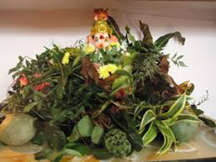
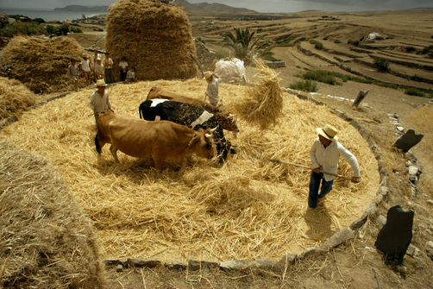
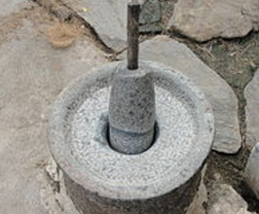
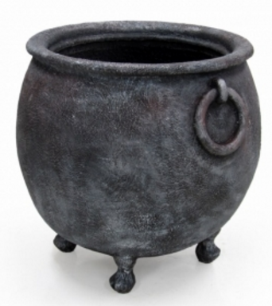
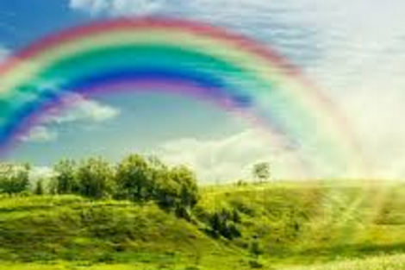
Puzzle #6
6/18
4/15
8/9
6/9
6/7

Slide 7
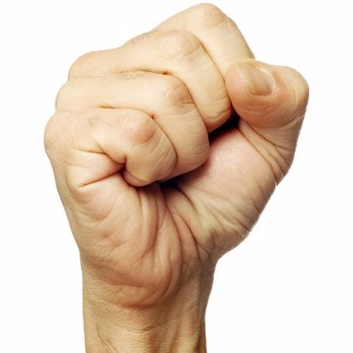
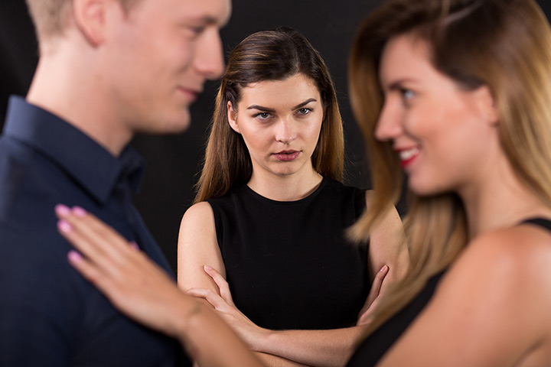
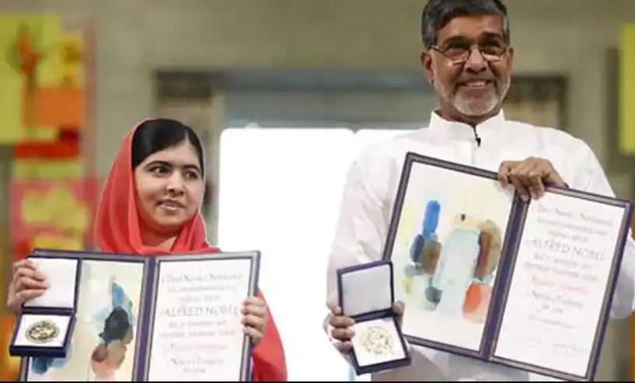
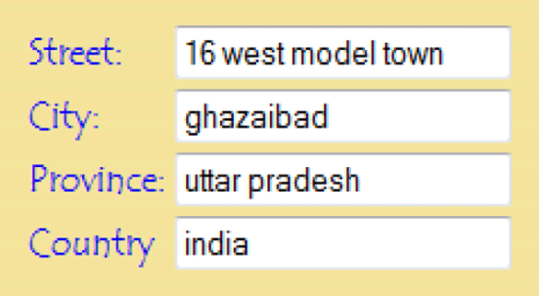
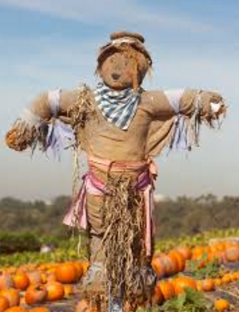
Puzzle #7
4/6
2/8
3/12
4/15
8/9

Slide 8
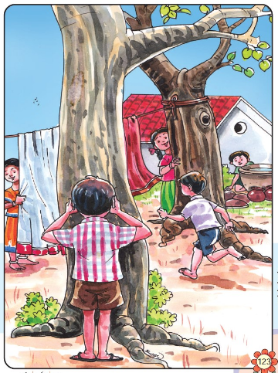
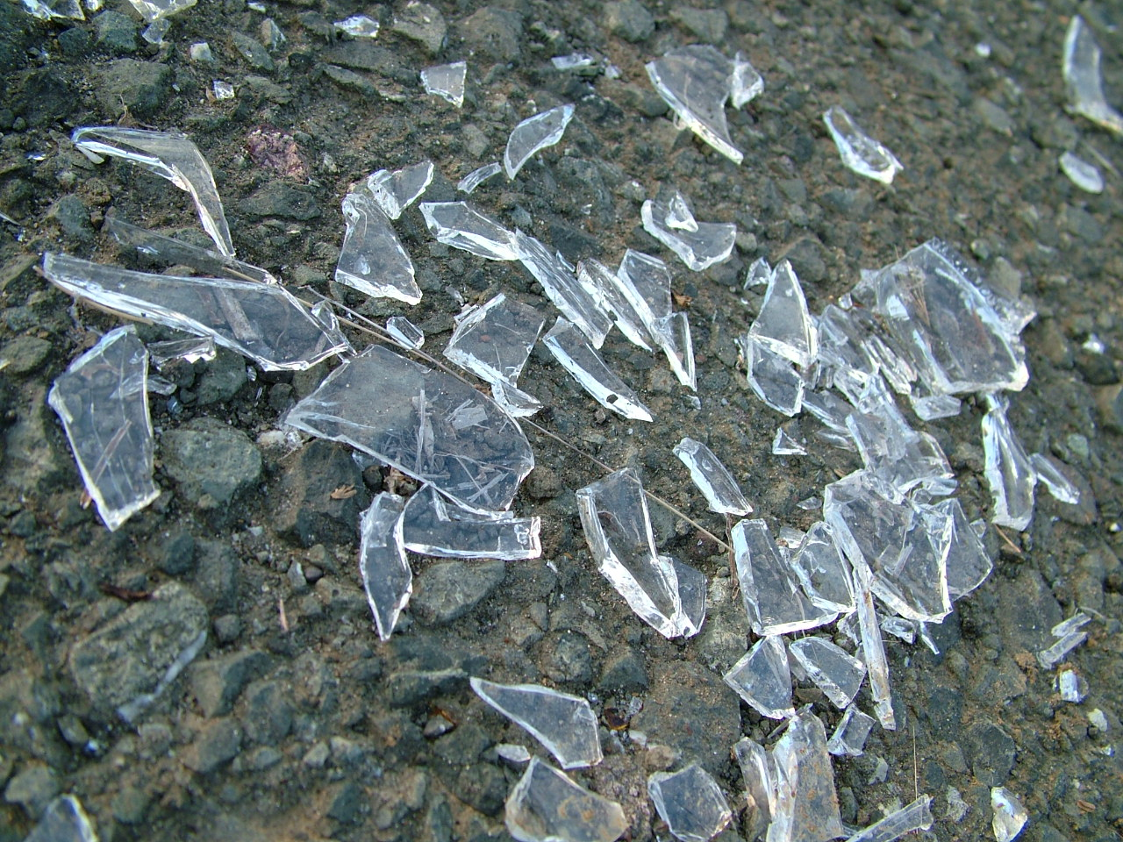
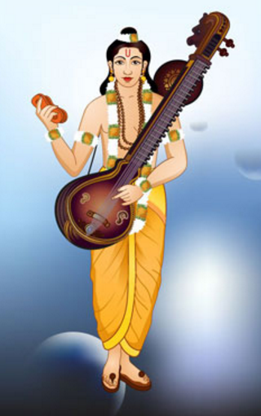
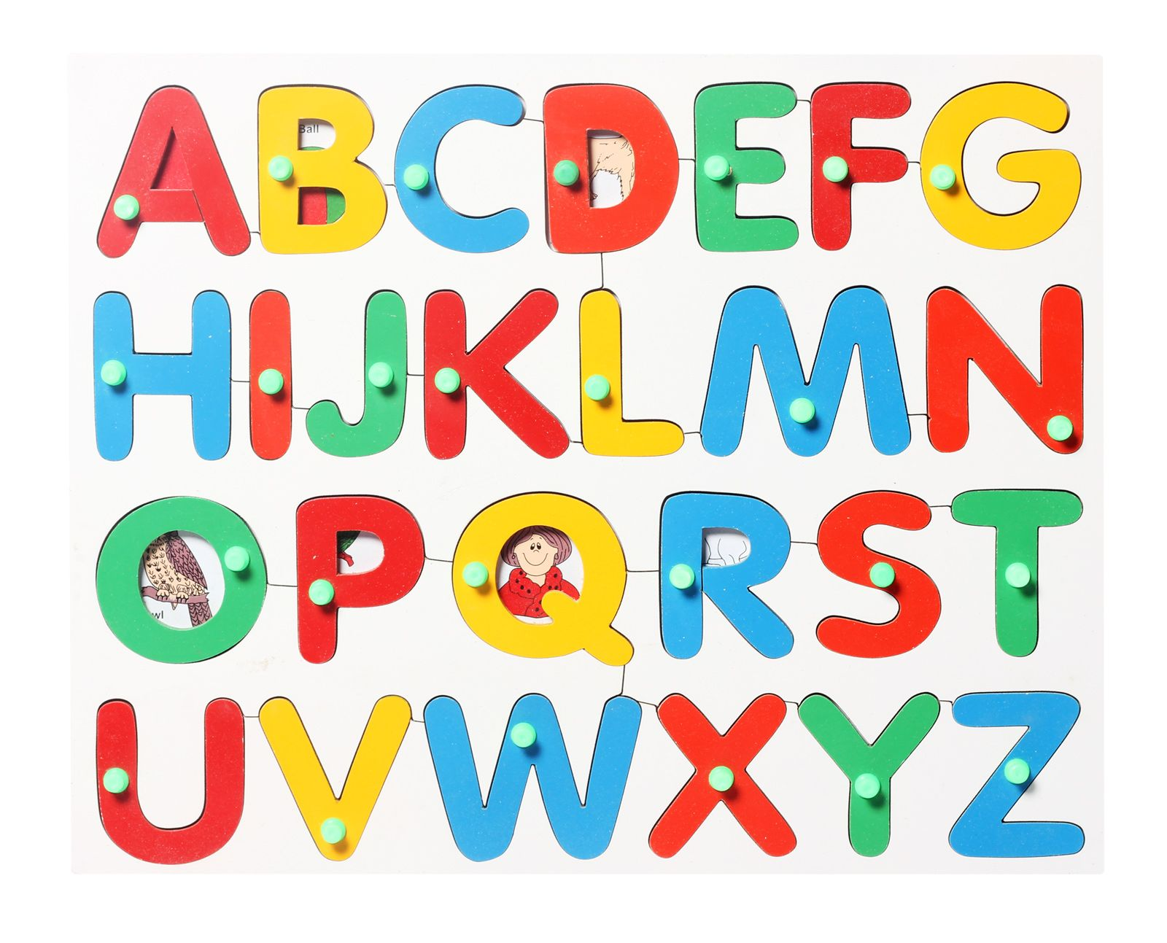
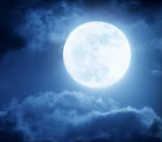
Puzzle #8
1/4
5/21
1/11
2/8
2/4

Slide 9
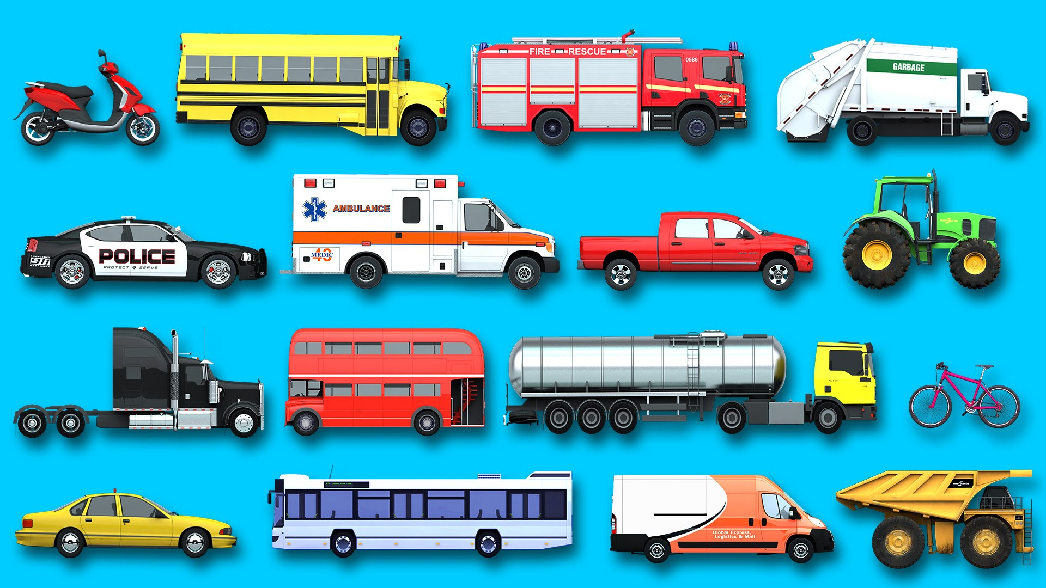
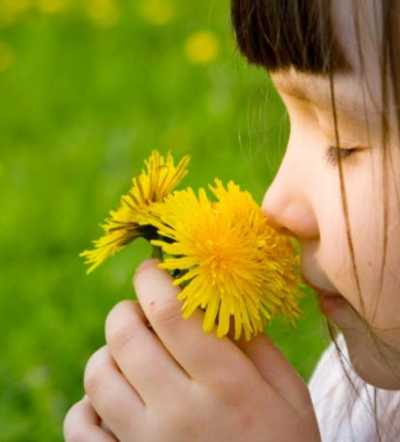
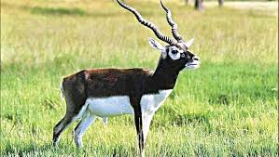
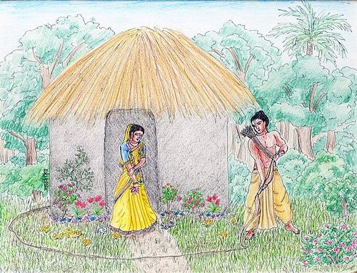
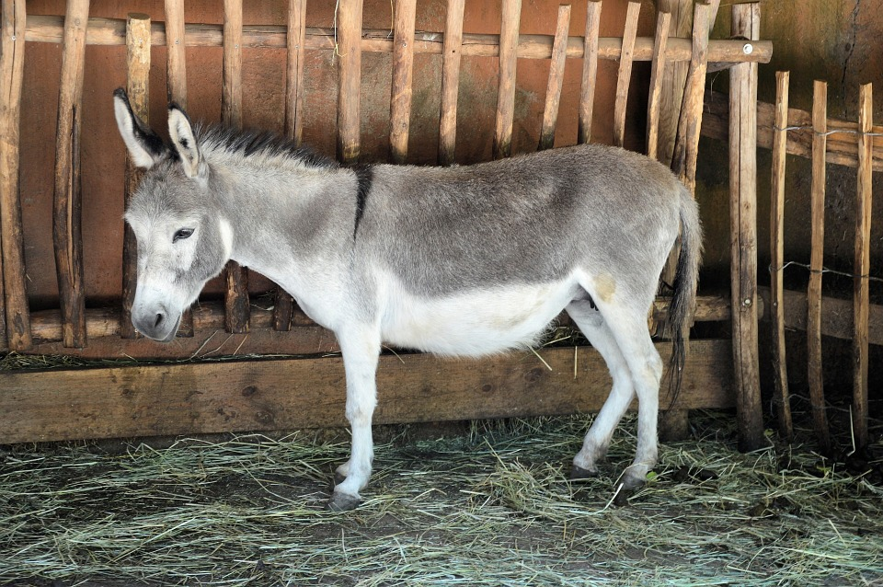
Puzzle #9
3/8
9/9
2/9
1/14
2/6

Slide 10

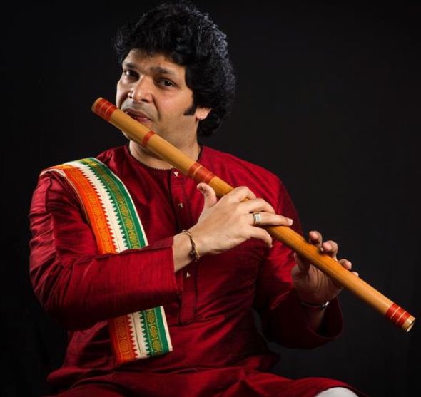
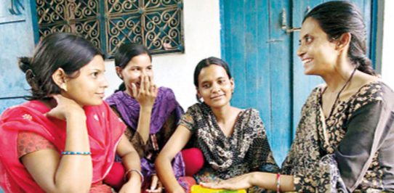
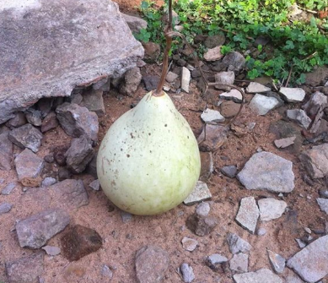
Puzzle #10
11/12
5/15
2/7
5/11
2/14

Slide 11
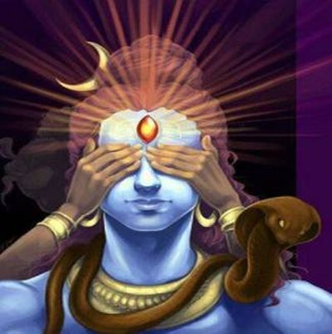
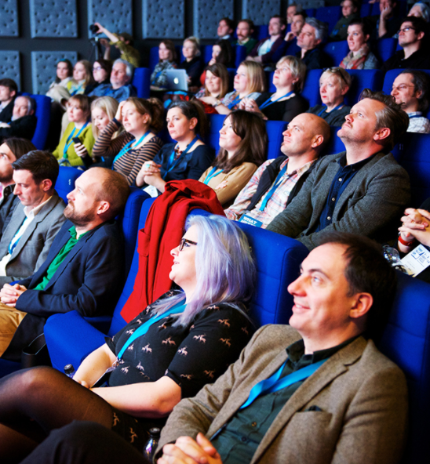
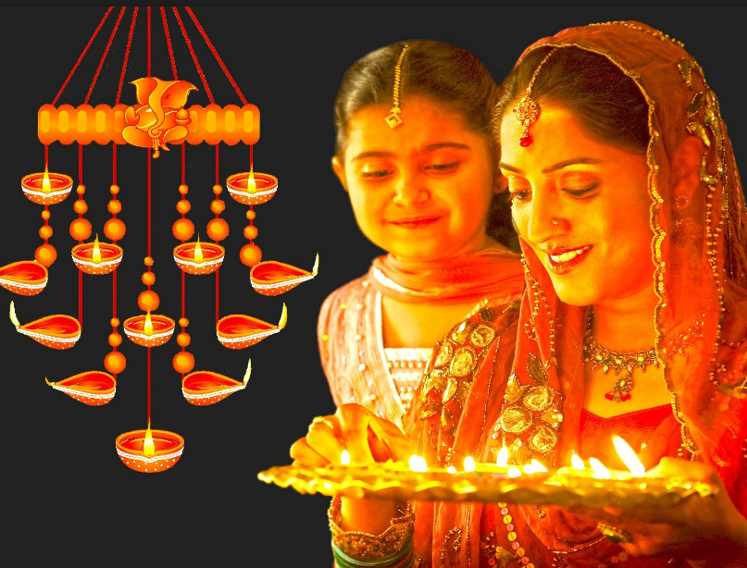
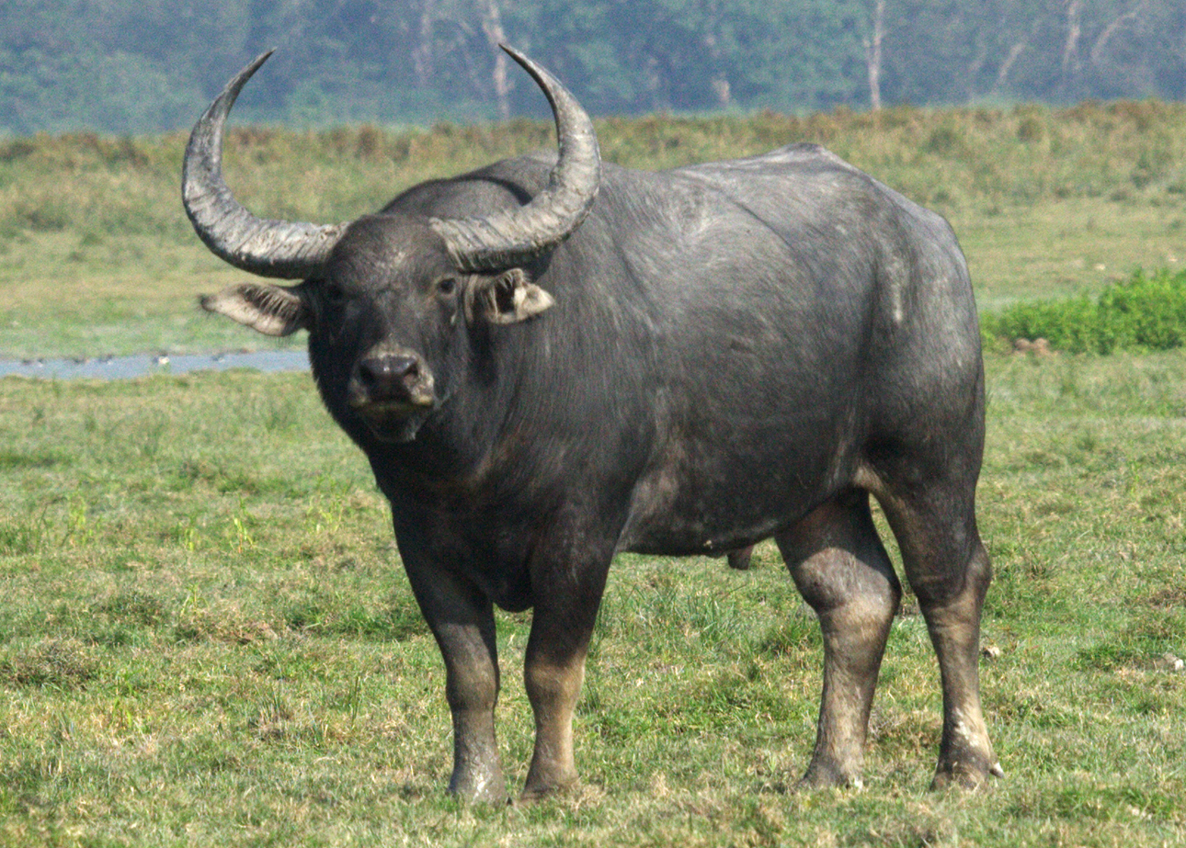
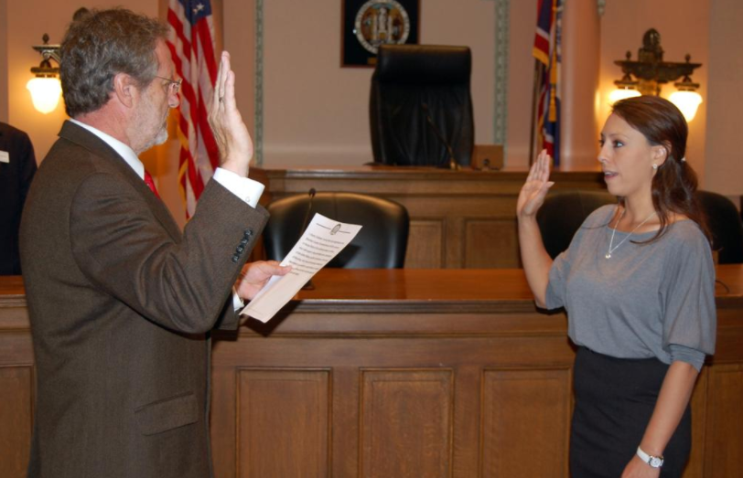
Puzzle #11
2/15
5/8
7/8
6/7
2/10

Slide 12



Puzzle #12
9/10
5/11
2/5
6/9
1/10

Slide 13





Puzzle #13
6/7
4/12
1/4
1/9
2/12

Slide 14




Puzzle #14
2/5
4/9
6/12
14/15
7/7

Slide 15




Puzzle #15
6/6
4/14
3/18
5/8
2/10

Slide 16





Puzzle #16
4/9
5/6
13/14
6/17
5/7

Slide 17





Puzzle #17
5/14
3/6
3/5
1/9
3/5

Slide 18




Puzzle #18
1/11
3/5
7/7
3/7
4/6

Slide 19





Puzzle #19
1/6
2/4
1/10
3/8
5/6

Slide 20




Puzzle #20
5/7
2/5
1/9
1/10
6/13

Slide 21
#1 (2/5) cheek | (2/6) temple | (6/7) article | (6/10) astrologer | (2/6) sorrow
#2 (9/10) saraswathi | (2/7) pelican | (1/13) lord balarama | (1/8) lakshman | (5/7) airport
#3 (1/7) husband | (2/10) temple top | (3/13) billa sunnamu | (3/10) cultivator | (4/15) throwinthetowel
#4 (8/10) friendship | (6/11) square root | (6/6) pistol | (5/6) jukalu | (2/6) doctor
#5 (4/6) mother | (5/10) to_be_done | (8/13) guddapilikalu | (1/12) lord ganesha | (2/7) tornado
#6 (6/18) ganesha_patri_puja | (4/15) threshing_floor | (8/9) rubburolu | (6/9) gangalamu | (6/7) rainbow
#7 (4/6) rights | (2/8) jealousy | (3/12) felicitation | (4/15) mailing address | (8/9) scarecrow
#8 (1/4) hide | (5/21) broken piece of glass | (1/11) lord narada | (2/8) alphabet | (2/4) moon
#9 (3/8) vehicles | (9/9) fragrance | (2/9) blackbuck | (1/14) lakshmanarekha | (2/6) donkey
#10 (11/12) lord ganesha | (5/15) monkeysandstick | (2/7) flutist | (5/11) ammalakkalu | (2/14) some_vegetable
#11 (2/15) shiva_third_eye | (5/8) audience | (7/8) dipavali | (6/7) buffalo | (2/10) to_be_done
#12 (9/10) saraswathi | (5/11) fingerprint | (2/5) elbow | (6/9) gangalamu | (1/10) odd number
#13 (6/7) paratha | (4/12) interruption | (1/4) lady | (1/9) lice comb | (2/12) boppayipandu
#14 (2/5) thief | (4/9) affection | (6/12) erukala sani | (14/15) gottam vadiyalu | (7/7) buffalo
#15 (6/6) search | (4/14) fire pit stove | (3/18) talapatragranthamu | (5/8) cot legs | (2/10) to_be_done
#16 (4/9) fishermen | (5/6) donkey | (13/14) muharram pirlu | (6/17) troublesome woman | (5/7) support
#17 (5/14) elephant trunk | (3/6) speech | (3/5) color | (1/9) loincloth | (3/5) crown
#18 (1/11) handicapped | (3/5) guest | (7/7) nostril | (3/7) millets | (4/6) mahout
#19 (1/6) hanger | (2/4) bear | (1/10) lord shiva | (3/8) atlakada | (5/6) citron
#20 (5/7) ayodhya | (2/5) nerve | (1/9) lubricant | (1/10) lord shiva | (6/13) tax collector

Slide 22
#1 (2/5) cheek | (2/6) temple | (6/7) article | (6/10) astrologer | (2/6) sorrow
#2 (9/10) saraswathi | (2/7) pelican | (1/13) lord balarama | (1/8) lakshman | (5/7) airport
#3 (1/7) husband | (2/10) temple top | (3/13) billa sunnamu | (3/10) cultivator | (4/15) throwinthetowel
#4 (8/10) friendship | (6/11) square root | (6/6) pistol | (5/6) jukalu | (2/6) doctor
#5 (4/6) mother | (5/10) to_be_done | (8/13) guddapilikalu | (1/12) lord ganesha | (2/7) tornado
#6 (6/18) ganesha_patri_puja | (4/15) threshing_floor | (8/9) rubburolu | (6/9) gangalamu | (6/7) rainbow
#7 (4/6) rights | (2/8) jealousy | (3/12) felicitation | (4/15) mailing address | (8/9) scarecrow
#8 (1/4) hide | (5/21) broken piece of glass | (1/11) lord narada | (2/8) alphabet | (2/4) moon
#9 (3/8) vehicles | (9/9) fragrance | (2/9) blackbuck | (1/14) lakshmanarekha | (2/6) donkey
#10 (11/12) lord ganesha | (5/15) monkeysandstick | (2/7) flutist | (5/11) ammalakkalu | (2/14) some_vegetable
#11 (2/15) shiva_third_eye | (5/8) audience | (7/8) dipavali | (6/7) buffalo | (2/10) to_be_done
#12 (9/10) saraswathi | (5/11) fingerprint | (2/5) elbow | (6/9) gangalamu | (1/10) odd number
#13 (6/7) paratha | (4/12) interruption | (1/4) lady | (1/9) lice comb | (2/12) boppayipandu
#14 (2/5) thief | (4/9) affection | (6/12) erukala sani | (14/15) gottam vadiyalu | (7/7) buffalo
#15 (6/6) search | (4/14) fire pit stove | (3/18) talapatragranthamu | (5/8) cot legs | (2/10) to_be_done
#16 (4/9) fishermen | (5/6) donkey | (13/14) muharram pirlu | (6/17) troublesome woman | (5/7) support
#17 (5/14) elephant trunk | (3/6) speech | (3/5) color | (1/9) loincloth | (3/5) crown
#18 (1/11) handicapped | (3/5) guest | (7/7) nostril | (3/7) millets | (4/6) mahout
#19 (1/6) hanger | (2/4) bear | (1/10) lord shiva | (3/8) atlakada | (5/6) citron
#20 (5/7) ayodhya | (2/5) nerve | (1/9) lubricant | (1/10) lord shiva | (6/13) tax collector

Slide 23
#1 (2/5) cheek | (2/6) temple | (6/7) article | (6/10) astrologer | (2/6) sorrow
#2 (9/10) saraswathi | (2/7) pelican | (1/13) lord balarama | (1/8) lakshman | (5/7) airport
#3 (1/7) husband | (2/10) temple top | (3/13) billa sunnamu | (3/10) cultivator | (4/15) throwinthetowel
#4 (8/10) friendship | (6/11) square root | (6/6) pistol | (5/6) jukalu | (2/6) doctor
#5 (4/6) mother | (5/10) to_be_done | (8/13) guddapilikalu | (1/12) lord ganesha | (2/7) tornado
#6 (6/18) ganesha_patri_puja | (4/15) threshing_floor | (8/9) rubburolu | (6/9) gangalamu | (6/7) rainbow
#7 (4/6) rights | (2/8) jealousy | (3/12) felicitation | (4/15) mailing address | (8/9) scarecrow
#8 (1/4) hide | (5/21) broken piece of glass | (1/11) lord narada | (2/8) alphabet | (2/4) moon
#9 (3/8) vehicles | (9/9) fragrance | (2/9) blackbuck | (1/14) lakshmanarekha | (2/6) donkey
#10 (11/12) lord ganesha | (5/15) monkeysandstick | (2/7) flutist | (5/11) ammalakkalu | (2/14) some_vegetable
#11 (2/15) shiva_third_eye | (5/8) audience | (7/8) dipavali | (6/7) buffalo | (2/10) to_be_done
#12 (9/10) saraswathi | (5/11) fingerprint | (2/5) elbow | (6/9) gangalamu | (1/10) odd number
#13 (6/7) paratha | (4/12) interruption | (1/4) lady | (1/9) lice comb | (2/12) boppayipandu
#14 (2/5) thief | (4/9) affection | (6/12) erukala sani | (14/15) gottam vadiyalu | (7/7) buffalo
#15 (6/6) search | (4/14) fire pit stove | (3/18) talapatragranthamu | (5/8) cot legs | (2/10) to_be_done
#16 (4/9) fishermen | (5/6) donkey | (13/14) muharram pirlu | (6/17) troublesome woman | (5/7) support
#17 (5/14) elephant trunk | (3/6) speech | (3/5) color | (1/9) loincloth | (3/5) crown
#18 (1/11) handicapped | (3/5) guest | (7/7) nostril | (3/7) millets | (4/6) mahout
#19 (1/6) hanger | (2/4) bear | (1/10) lord shiva | (3/8) atlakada | (5/6) citron
#20 (5/7) ayodhya | (2/5) nerve | (1/9) lubricant | (1/10) lord shiva | (6/13) tax collector

